Slide 1
Reduce CO2 emissions
Yasmina Hobeika

Slide 2
Why this topic?
CO2 emissions are a major contributor to climate change and have harmful effects on human health, ecosystems, and the environment
The sources of CO2 emissions are diverse and include the burning of fossil fuels for transportation, electricity generation, and industrial processes
It is estimated that by 2099, the world could be 4°C warmer than pre-Industrial Revolution levels
So… We should act!

Slide 3






Who are the Decision Makers?
Government and Policy Makers
International Organizations and NGOs
Industries and head of factories
Individuals and Consumers
Notes:
International organizations such as the United Nations (UN) and IPCC

Slide 4
Datasets
CO2 and Greenhouse Gas Emissions
79 features
50598 rows
Poverty
4 features
CO2 emissions of all world by sector
56 features
6942 rows
1036 rows
Low income countries vs CO2
CO2 emission by sector

Slide 5
Data Modeling

Slide 6
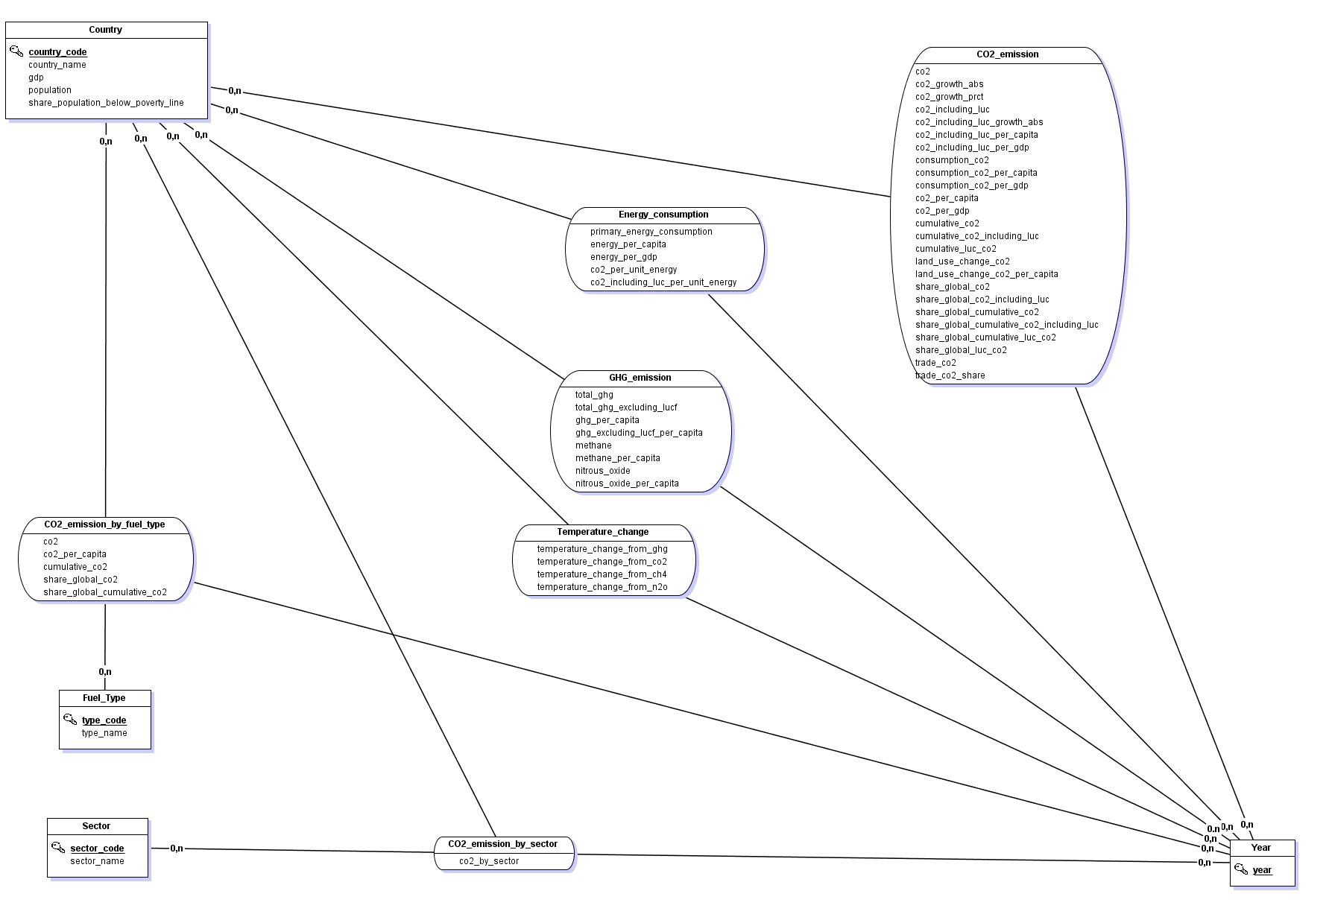
Entity-Relationship Schema
4 Entities
6 Relationships
2 ternary

Slide 7
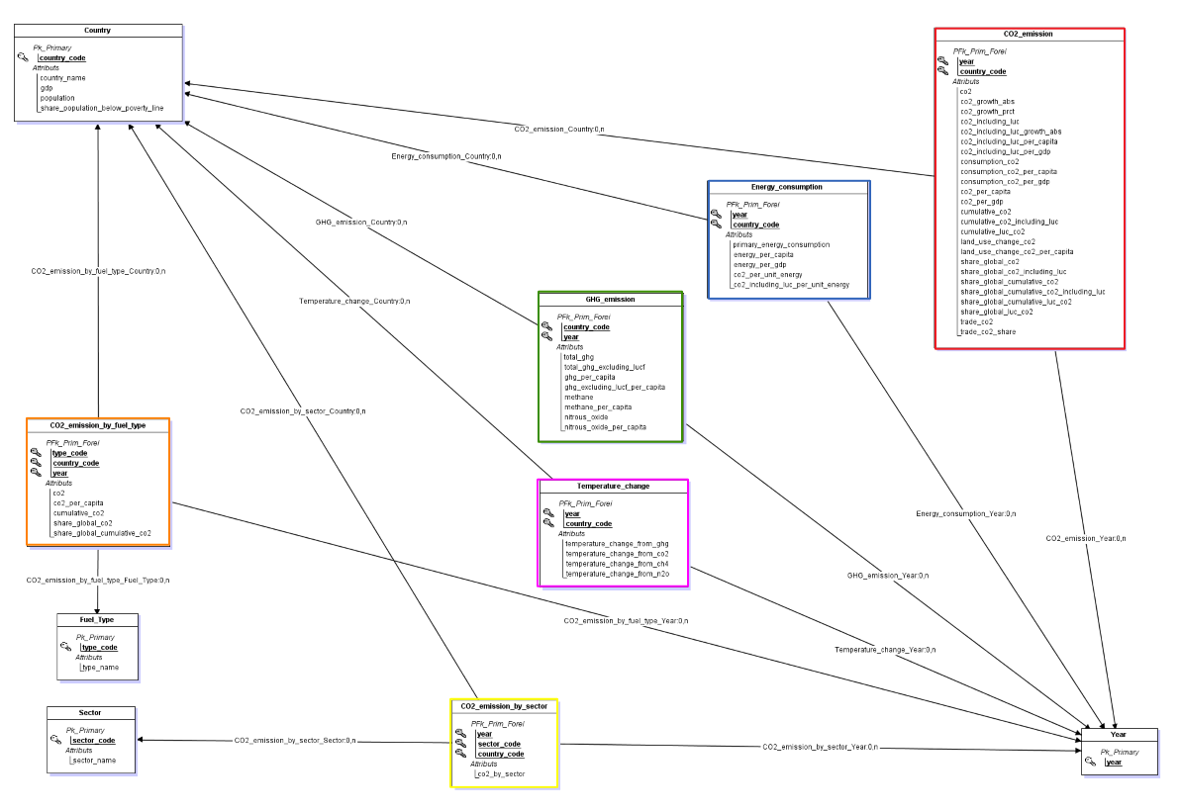
Snowflake Schema
6 fact tables
9 tables implemented in Excel
only Year not implemented (single-attribute table)

Slide 8
Visualization

Slide 9
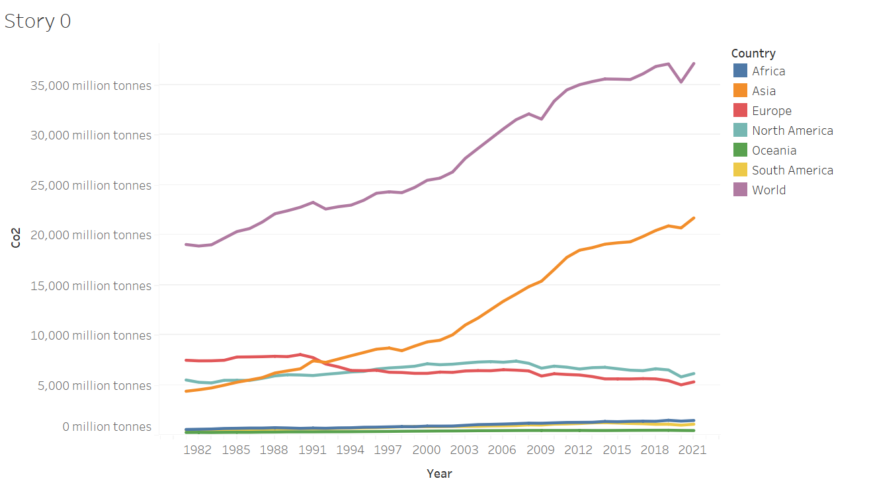
Analysis of CO2 Emissions in Continents over Time - 1
It is evident that global CO2 emissions have been experiencing exponential growth over the years. Asia emerges as the frontrunner, surpassing other continents in terms of emissions. Let's dig deeper into the countries of these continents.

Slide 10
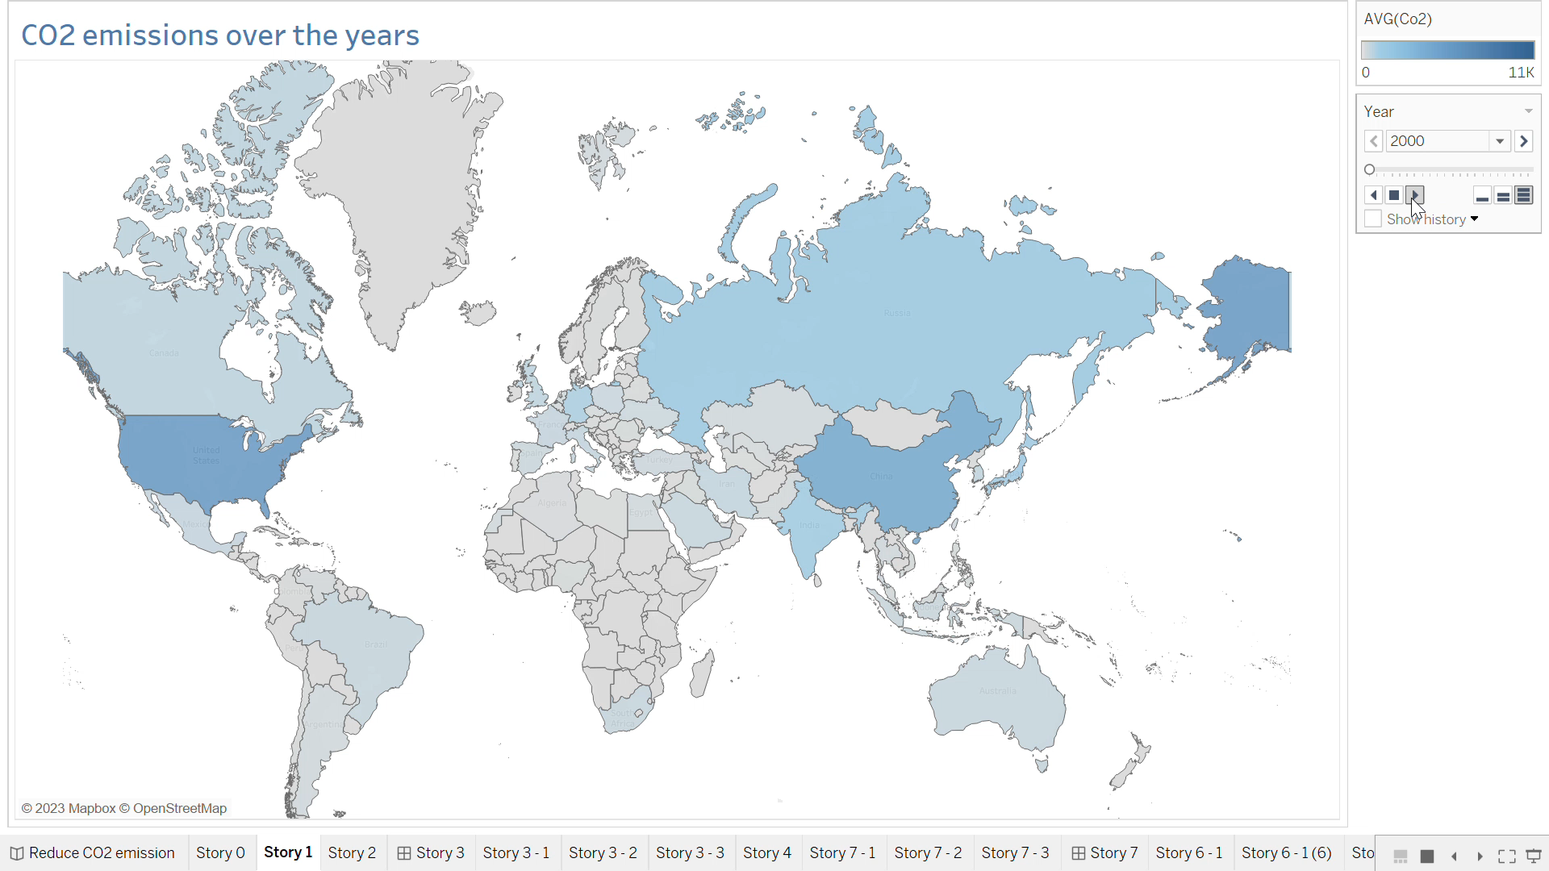
CO2 Emissions over the years
This video illustrates the global distribution of CO2 emissions on a world map. This chart is showing the increase of CO2 emissions over the world as the blue color is getting darker and darker over the years in most of the countries. Developing countries, such as China, tend to have the highest levels of CO2 emissions and have consistently ranked at the top, as it is the darkest one. The United States, Russia and India are also playing an important role in the increase of CO2 emission in the last 10 years.

Slide 11
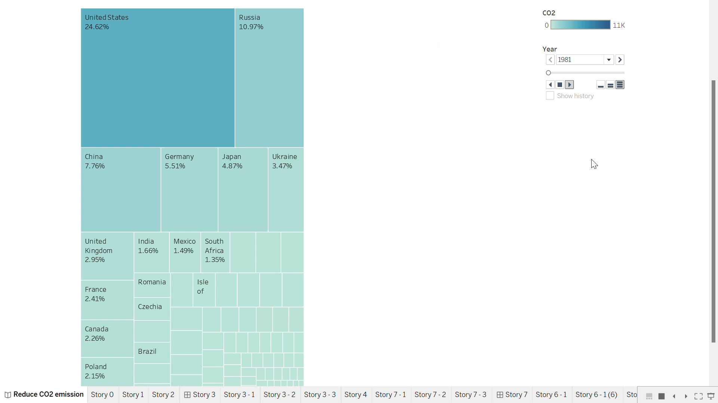
Global share of CO2 in each country
The most problematic countries occupy the most significant area. Each country is represented by blocks of varying colors and sizes, arranged in order of severity from the top-left. After 2006, China stands out as the leading contributor to global CO2 emissions, followed by the United States in second place, followed by India in third place. The percentage next to each country represent its global share of CO2. China, United States, India, Russia and Japan account for more than 50% of the whole CO2 emission over the world.

Slide 12
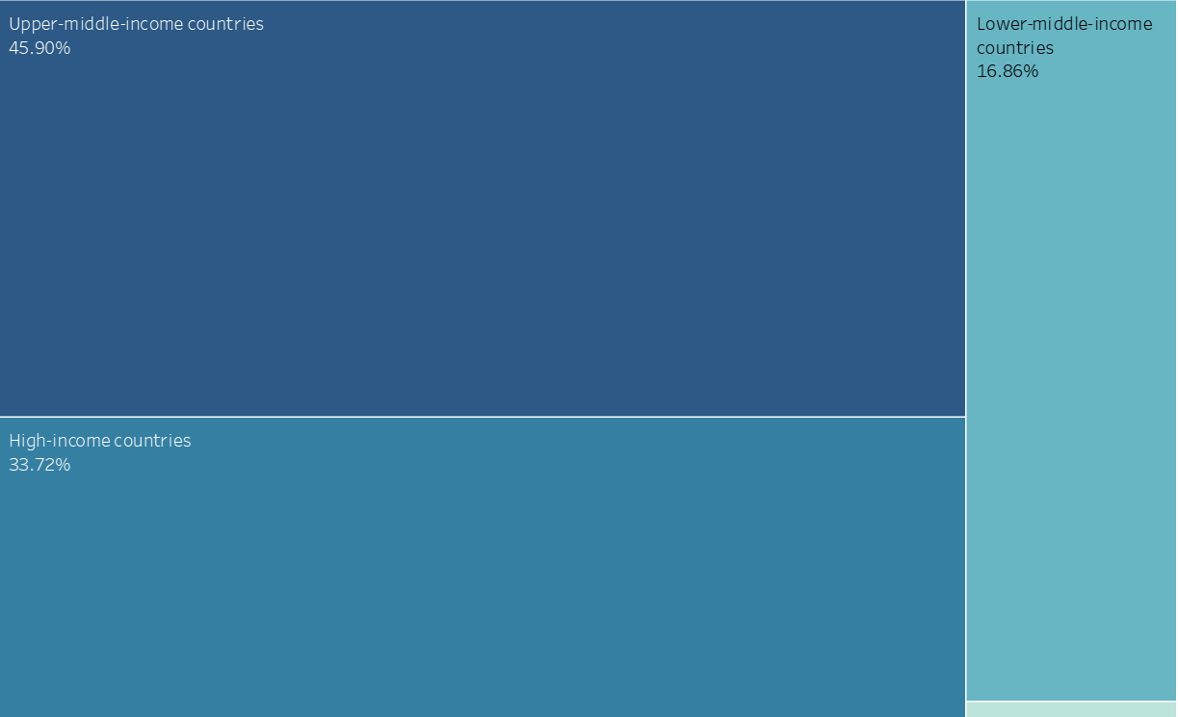
Global share of CO2 in countries by income level
Taking a different perspective, it's interesting to observe that the countries with the highest CO2 emissions over all the years are the developed nations, meaning higher income levels. This correlation suggests a strong link between economic prosperity and carbon emissions.

Slide 13
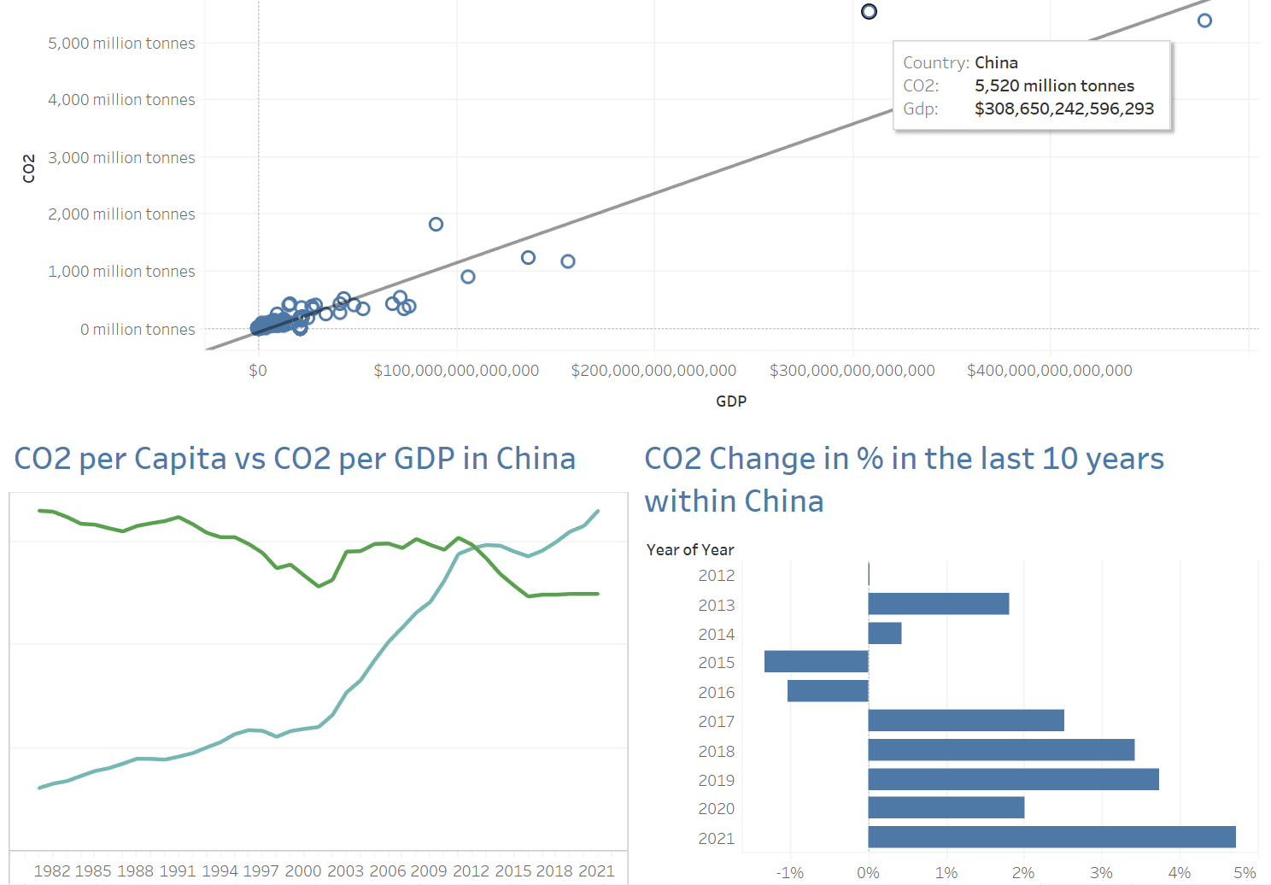
CO2 emission vs GDP - 1
The first graph showcases a strong positive correlation between economic growth and CO2 emissions. As the GDP of a country is higher, so does its CO2 emissions.

Slide 14
CO2 emission vs GDP - 2
When hovering over a scatter dot, we can observe the average CO2 emissions per capita and CO2 emissions per GDP over the years for that specific country. For instance, China has experienced a significant surge in CO2 emissions per capita over the past decade, while we see in the Covid period a decrease in CO2 per GDP, probably because industries and transportation means were closed. Furthermore, the graph highlights the percentage change in CO2 emissions over the last 10 years, and we can see a constant increase in China.

Slide 15
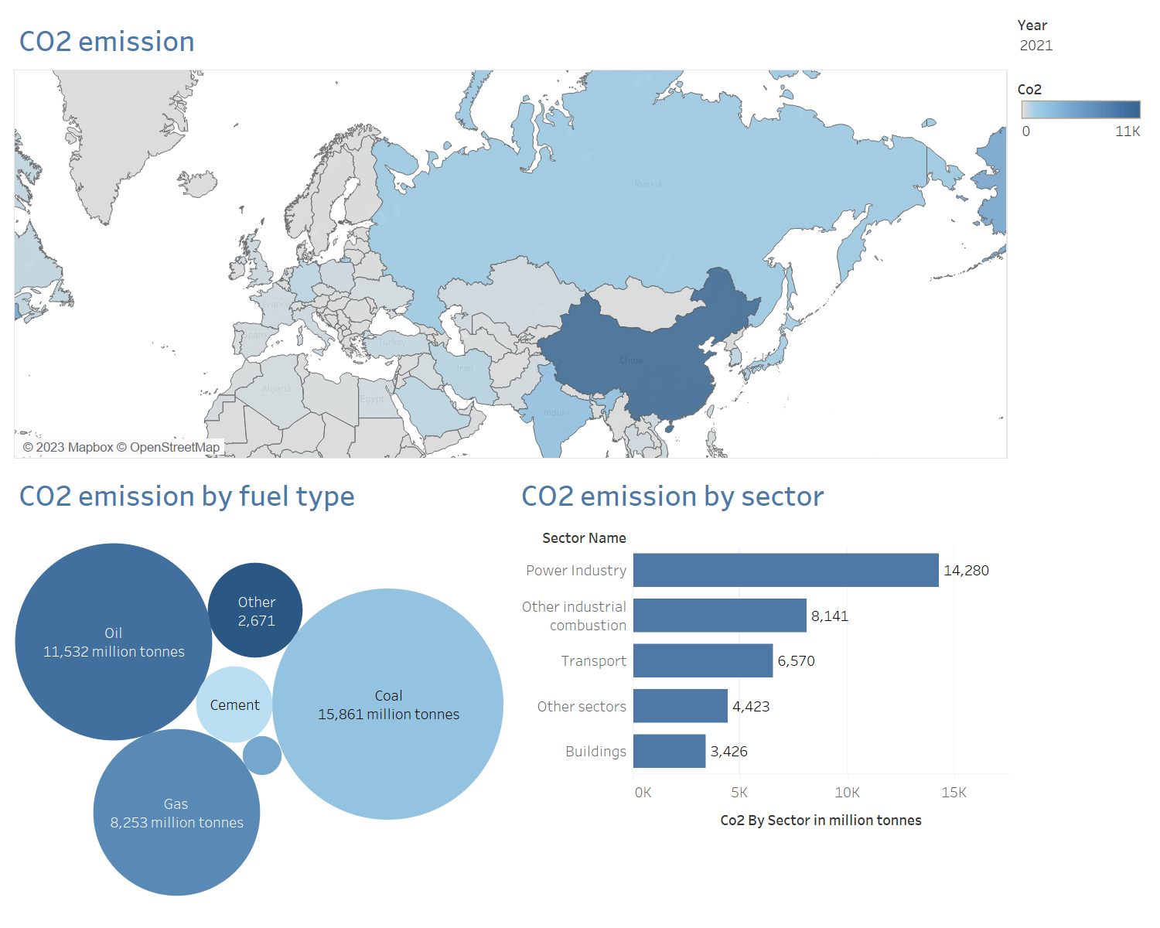
Global CO2 emission by fuel type and by sector in 2021
Let's explore the CO2 emissions on a global scale by analyzing the distribution of emissions by fuel type and sector across different countries over the years. It becomes evident that the Power Industry sector and Coal significantly contribute to global CO2 emissions

Slide 16
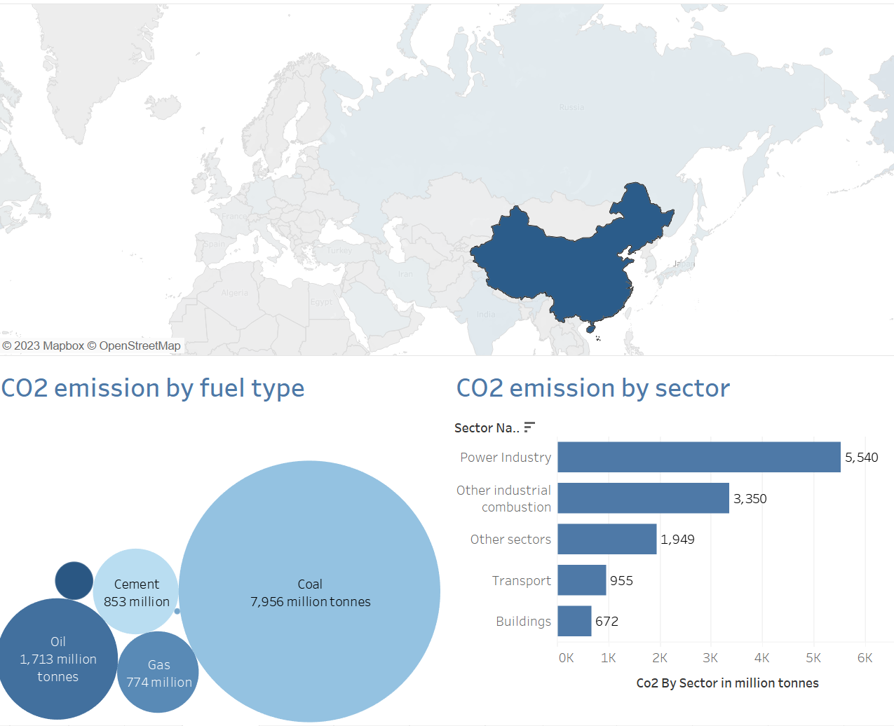
CO2 emission by fuel type and by sector in China in 2021
By selecting a specific country, we can delve deeper into understanding how the emission distribution varies within that country. For instance, in China, Coal takes a prominent position, same for the Power Industry sector. I noticed that China, the powerhouse in both production and population, emerges as the primary behind coal-related emissions. With a total CO2 of 7,956 million tons emitted by coal, China accounts for nearly half of the global coal-related CO2 emissions. In comparison, the rest of the world combined amounts to 15,861 million tons.

Slide 17
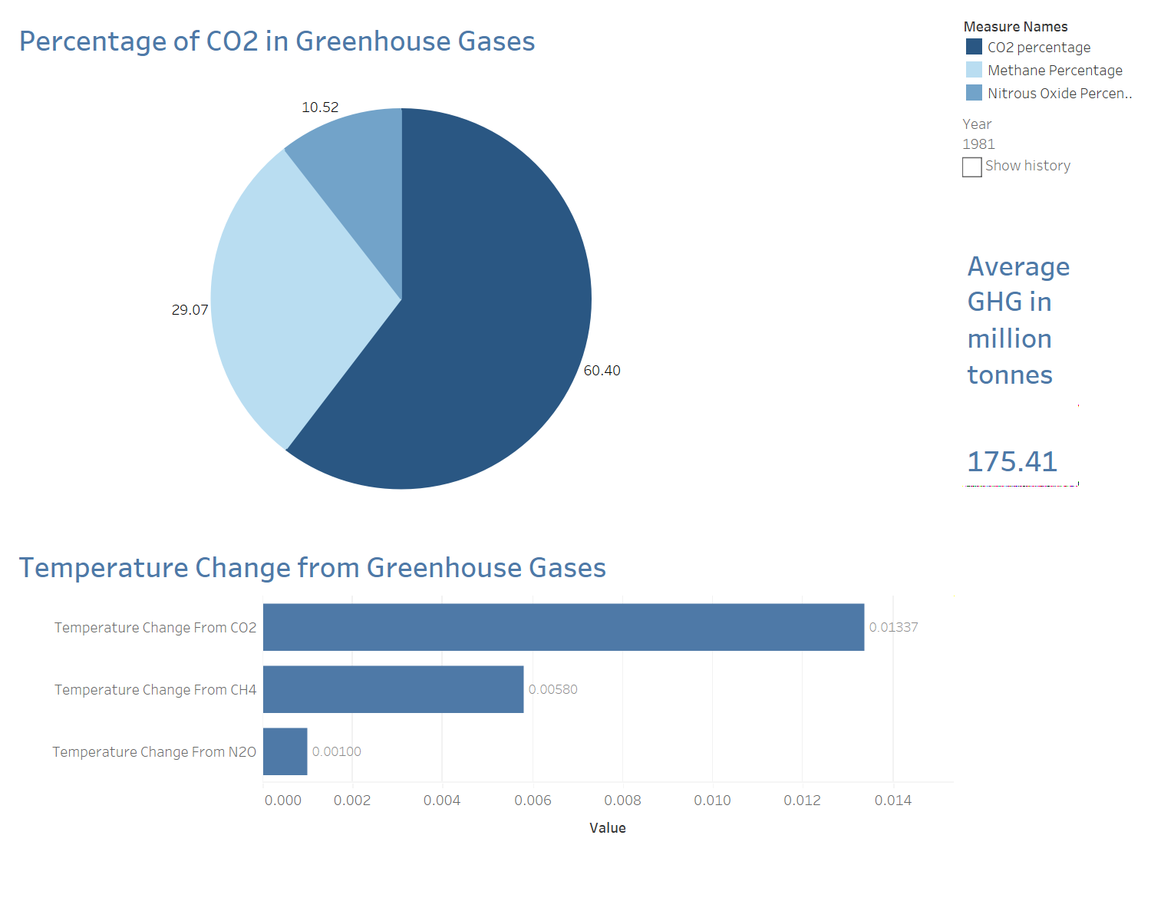
CO2 compared to other greenhouse gases in 2021 - 1
CO2 plays a central role in driving global climate change, but it's important to recognize that it is not the only greenhouse gas responsible for this phenomenon. Other greenhouse gases, such as methane (CH4) and nitrous oxide (N2O), also contribute to global warming. So let’s analyze the percentage of CO2 emissions compared to other greenhouse gases. Over the years, the percentage of CO2 emissions has been steadily increasing. In 1981, CO2 accounted for 60.4% of total greenhouse gas emissions.

Slide 18
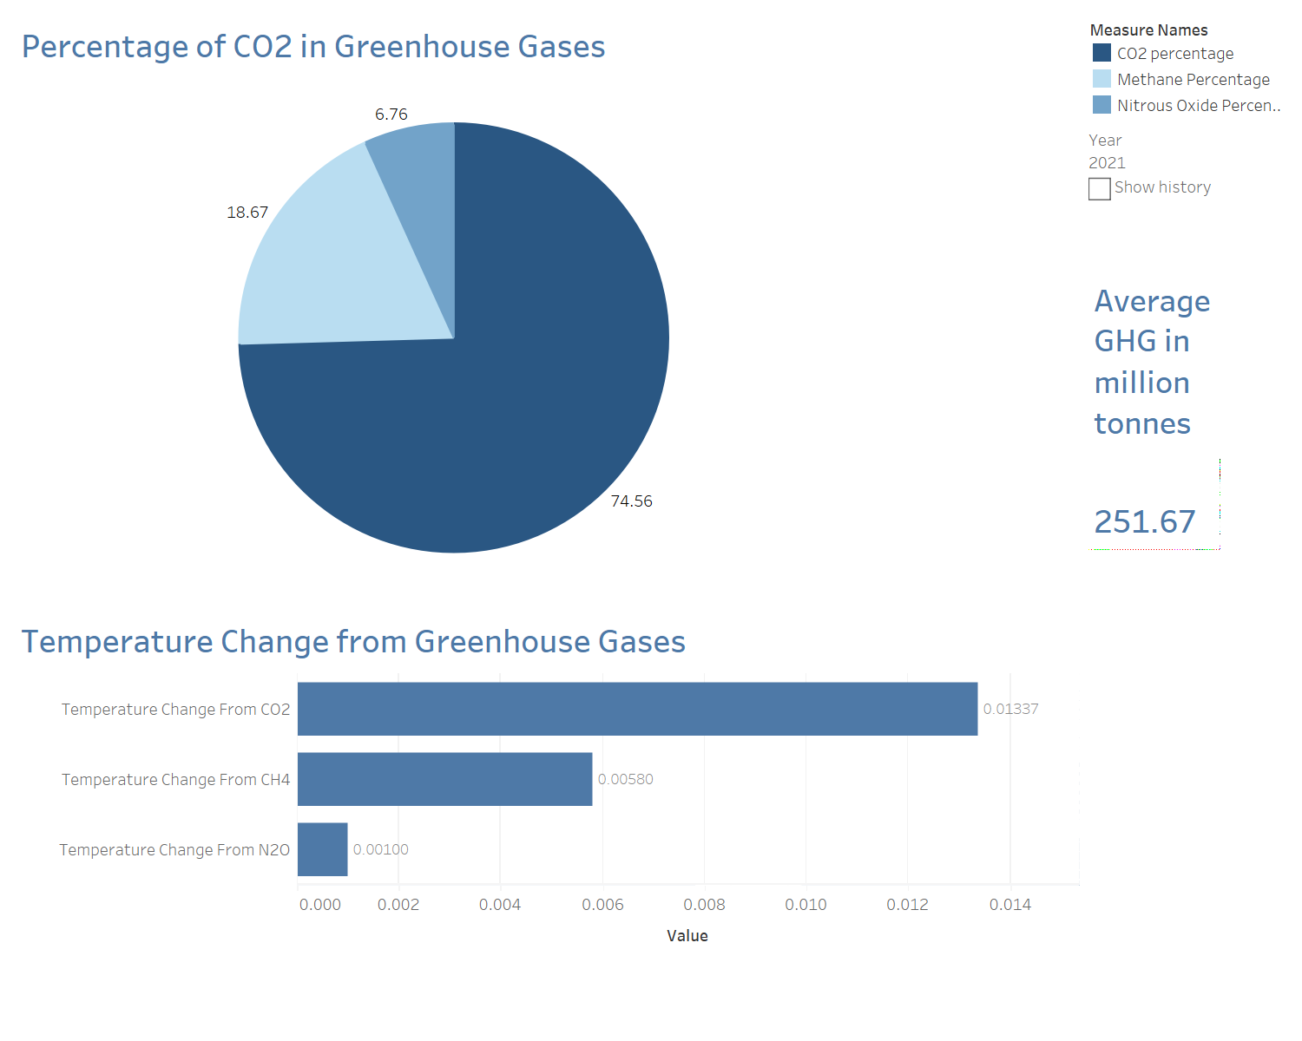
CO2 compared to other greenhouse gases in 2021 - 2
In 2021, CO2 rose to 74.56%. In addition to the increasing percentage of CO2 emissions compared to other greenhouse gases, we can notice that the overall quantity of greenhouse gas emissions is also on the rise. This means that not only is the proportion of CO2 emissions rising, but the overall quantity of greenhouse gas emissions is also growing.

Slide 19
CO2 compared to other greenhouse gases in 2021 - 3
In the second graph, we observe the temperature effects generated by different greenhouse gases. It is evident that CO2 contributes to higher temperature changes compared to CH4 and N2O. This finding highlights the significant role of CO2 as the most potent greenhouse gas driving climate change.

Slide 20
Recommendations
Especially for the top 5 emitters: China, India, Japan, United States, and Russia

Slide 21
Government and Policy Makers
Transition to Renewable Energy: Implement policies that encourage the deployment of renewable energy infrastructure such as solar, wind, hydro, and geothermal power
Carbon Pricing and Emissions Trading: Introduce carbon taxes that would provide incentives for businesses to reduce their CO2 emissions and invest in cleaner technologies
Sustainable Transportation: Promote the use of public transportation by creating special discounts (like carte avantage)
Sustainable Urban Planning: Establish green building practices and energy-efficient construction standards and regulations

Slide 22
International Organizations and NGOs
Public Awareness and Education: Launch public awareness campaigns to educate the public about the importance of reducing CO2 emissions
International Cooperation: Collaborate with other countries and participate actively in international agreements and initiatives aimed at reducing CO2 emissions, such as the Paris Agreement (international treaty on climate change)
Monitoring and Reporting: Support the establishment of robust monitoring, reporting, and verification systems to track progress in reducing CO2 emissions
Research and Innovation: Support research and innovation in clean energy technologies, sustainable practices, and climate solutions by funding these projects

Slide 23
Industries and Head of Factories
Energy Efficiency Improvements: Conduct energy audits, upgrading equipment and machinery to energy-efficient models, improving insulation, and adopting smart energy management systems
Transition to Renewable Energy: Invest in renewable energy sources such as solar, wind, and hydropower to meet the energy needs of factories + Install on-site or off-site renewable energy generation systems to reduce reliance on fossil fuels
Carbon Capture and Storage (CCS): This helps to capture CO2 and prevent its release into the atmosphere
Employee Engagement and Training: Educate and engage employees in sustainable practices and provide training on energy efficiency, waste reduction, and emission control

Slide 24
Individuals and Consumers
Energy Conservation: Reduce energy consumption in your daily life by turning off lights and appliances when not in use, using energy-efficient LED bulbs, and optimizing heating and cooling settings
Transportation Choices: Opt for sustainable transportation options like public transportation, carpool, bike, or walk instead of relying heavily on personal vehicles
Reduce, Reuse, Recycle: Practice the principles of the circular economy by reducing waste generation, reusing items, and recycling materials
Conscious Consumption: Make informed choices when purchasing goods and services. Prioritize products that are sustainably produced, energy-efficient, and have a lower environmental impact

Slide 25
Lets nurture the nature, so that we can have a better future!

Slide 26
Thank you!

